Slide 1
wo
Spricht man
Deutsch?

Slide 2
German is spoken by an estimated 126 million people!
Most of them are found in Germany (Deutschland), which has about 82 million German-speakers. But that still leaves 44 million others. Where are the rest?

Slide 3
German Is the Dominant Language of:
Germany - 82.7 million
Austria - 8.1 million
Switzerland - 4.6 million¹
Liechtenstein - 32,000
¹ The rest of Switzerland's 7.2 million citizens speak French, Italian and Romansch.

Slide 4
German Has Official Status in:
Luxembourg - 400,000²
Italy (Bolzano/Südtirol) - 200,000
Belgium - 70,000
² Lëtzebuergisch, a German dialect, is spoken by most Luxembourgers and German is the language of instruction in the lower grades. But French is used for official business.

Slide 5
German Is Regional/Minority Language in:
Former Soviet Union - 1.9 million³
France (Alsatian) - 1.5 million³
Poland (Silesia) - 500,000 (400,000)
Romania - 150,000⁴
Hungary - 62,000
Czech Republic - 50,000⁴
Denmark - 35,000
Slovakia - 15,000⁴
Other Areas: There are also minority groups of German dialect speakers found in certain areas of North America (Hutterites, Mennonites, Amish, etc.), in Kazakhstan, Namibia (former German Southwest Africa), Argentina, Paraguay, and other non-European regions.
³ This figure (from various sources) is probably too high because many of the ethnic Germans have now either been assimilated, died off, or left the region. ⁴ 1998 data (Romania, 1993) from Ethnologue.com

Slide 6
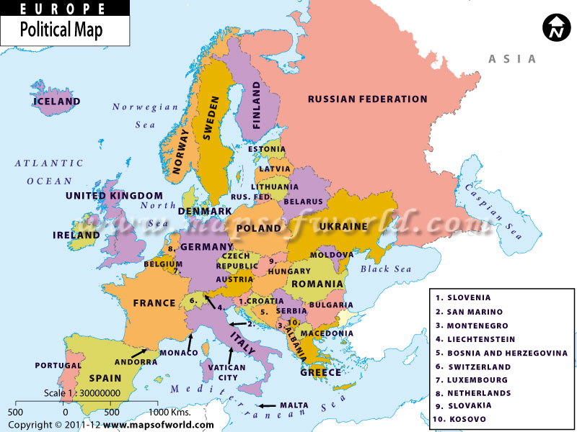

Slide 7
These figures are approximately 10 -12 years old and are only estimates.
Sources:
http://german.about.com/od/culture/a/germanspoken_3.htm
http://www.google.com/imgres?q=map+western+europe+printable&um=1&hl=en&safe=active&sa=N&biw=1024&bih=587&tbm=isch&tbnid=Tt_pCzhwFLyKGM:&imgrefurl=http://www.mapsofworld.com/europepoliticalmap.htm&docid=QeFwRWvtCLRT_M&imgurl=http://www.mapsofworld.com/images/europemap.jpg&w=800&h=600&ei=1kIhT_KuIIaftwfqq6CiCw&zoom=1&iact=hc&vpx=618&vpy=236&dur=311&hovh=194&hovw=259&tx=131&ty=112&sig=105862643221085640741&page=1&tbnh=115&tbnw=153&start=0&ndsp=18&ved=1t:429,r:16,s:0

