Slide 1
Où
parle-t-on français?

Slide 2
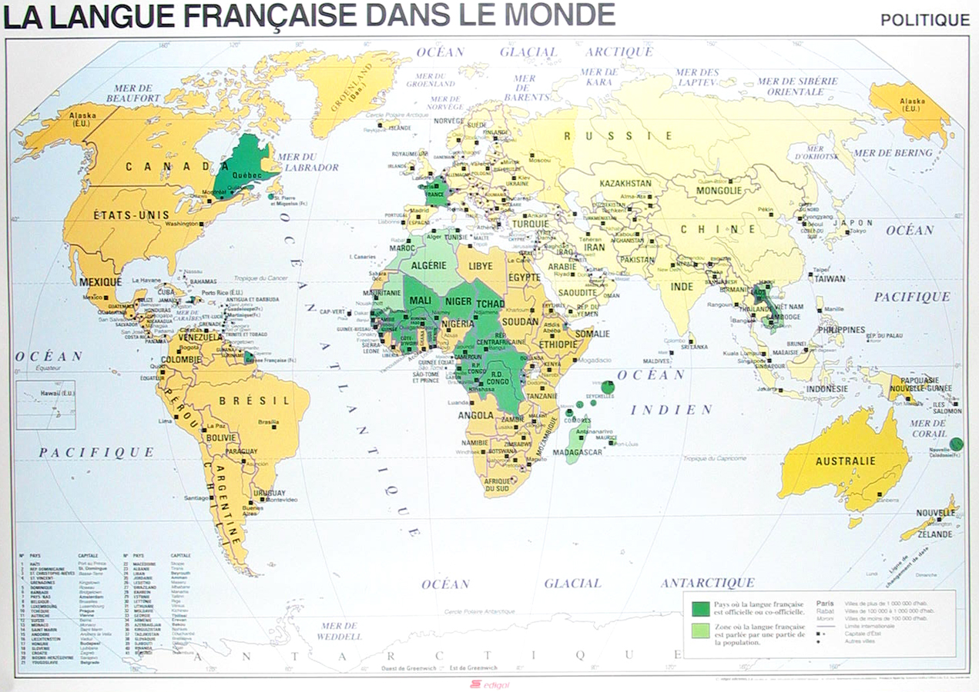

Slide 3
French is the official language of:
Bénin
Burkina Faso
Central African Republic
Democratic Republic of Congo
Republic of Congo
Côte d’Ivoire
Gabon
Guinea
Luxembourg
Mali
Monaco
Niger
Sénégal
Togo

Slide 4
French is also the official language of France’s overseas territories:
French Guyana
Guadeloupe
Martinique
La Réunion
French Polynesia
Mayotte
New Caledonia
St. Pierre et Miquelon
Wallis et Futuna
French southern and Antarctic lands

Slide 5
French is also the official language
of certain regions of multilingual
countries:
Belgium: Wallonie region
Canada: Québec province
Switzerland: Jura, Genève, Neuchâtel
and Vaud districts

Slide 6
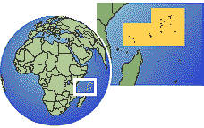
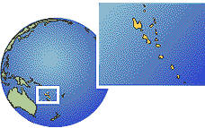
French is one of the official languages of:
Belgium
Burundi
Cameroon
Canada
Chad
Channel Islands (Guernsey and Jersey)
Comoros
Djibouti
Equatorial Guinea
Haiti (other official language is French Creole)
Madagascar
Rwanda
Seychelles
Switzerland
Vanuatu

Slide 7

French plays an important role, either as an administrative, commercial, or international language or simply has a significant French-speaking population:
Algeria Laos
Andorra Lebanon
Argentina Mauritania
Brazil Mauritius
Cambodia Morocco
Cape Verde Poland
Dominica (French patois) Saint Lucia
Egypt Syria
Greece Trinidad and Tobago
Grenada (French patois) Tunisia
Guinea-Bissau US (Louisiana, New England)
India Vatican City
Italy (Valle d’Aosta) Vietnam

Slide 8
French is one of the official working languages in the following international organizations: (There are many more.)
Organization (# official languages)
African Union (AU) (5)
Amnesty International (4)
Council of Europe (2)
European Commission (3)
Interpol (4)
International Criminal Court (2)
International Olympic Committee (2)
International Organization for Standardization (ISO) (2)
International Red Cross and Red Crescent (3)
Médecins Sans Frontières (Doctors without Borders) (1)
North American Free Trade Agreement (NAFTA) (3)
North Atlantic Treaty Organization (NATO) (2)
Organization for Economic Cooperation and Development (OECD) (2)
United Nations (UN) (6)
World Health Organization (WHO) (6)
World Trade Organization (WTO) (3)

Slide 9


NORTH AMERICA
Canada Louisiana

Slide 10





Islands
Haiti Martinique Guadeloupe
Tahiti New Caledonia

Slide 11





Belgium
europe
Luxembourg
France
Monaco
Switzerland

Slide 12
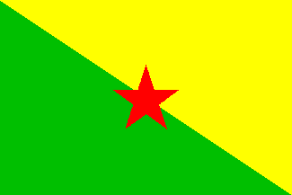



South America Asia
Vietnam
French Guiana
Laos
Cambodia

Slide 13























Africa
Algeria Bénin Burkina Faso Burundi Cameroon Congo
Ivory Coast Djibouti Gabon Guinea Madagascar Mali
Morocco Mauritania Niger Central African Zaire Rwanda
Republic
Sénégal Tchad Togo Tunisia Réunion

Slide 14
Sources:
http://french.about.com/od/francophonie/ss/whatisfrench.htm
http://cte.jhu.edu/techacademy/fellows/hintz/webquest2/sdhindex.html
http://nationsonline.org/oneworld/countries_by_languages.htm
https://ah-bon-french.wikispaces.com/file/view/Why+Learn+French
https://www.youtube.com/watch?v=lIGzg2ehdyk

